Slide 1
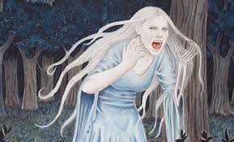
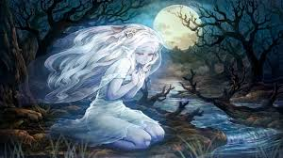
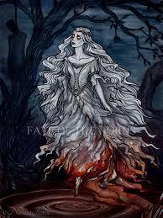
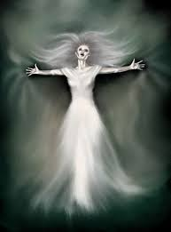
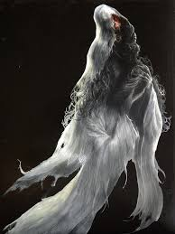
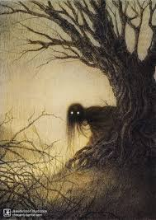
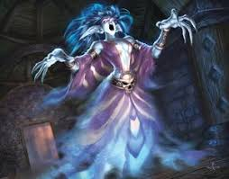
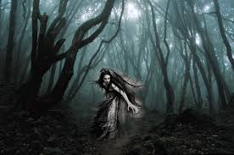
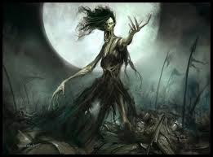
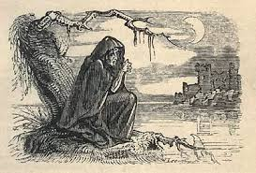
The Banshee
IAH 207 Group Presentation
By: Gabby Azzam, Hazal Butual, Aditya mahajan, Daniel Crisp, Cole Schaefer, Polina Stoppa , and Victoria Singleton

Slide 2
Movie trailer

Slide 3
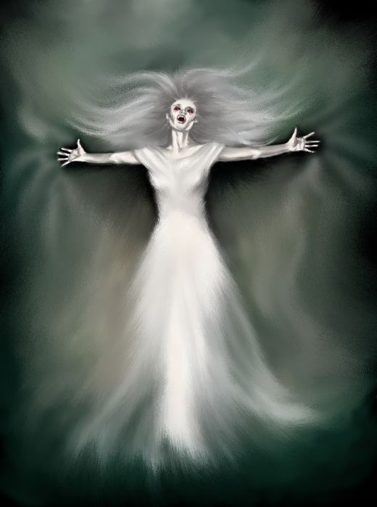
Origins of the Banshee
Aka the “supernatural death messenger”
Other names include: Bean-Sidhe, Badhbh, Keening Woman, & Washer Woman
Don’t cause death, simply warn that it is coming
Screams known as “caoine”
Is a female monster
Has an Irish and Scottish origin
First legends can be traced back to the 8th century
If a Banshee is seen, it’ll disappear into mist
Possibly called a Banshee because these women were “banished”

Slide 4
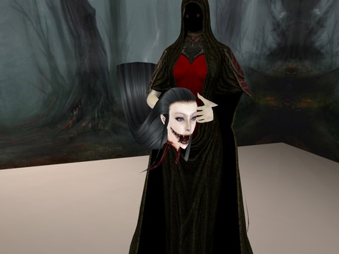
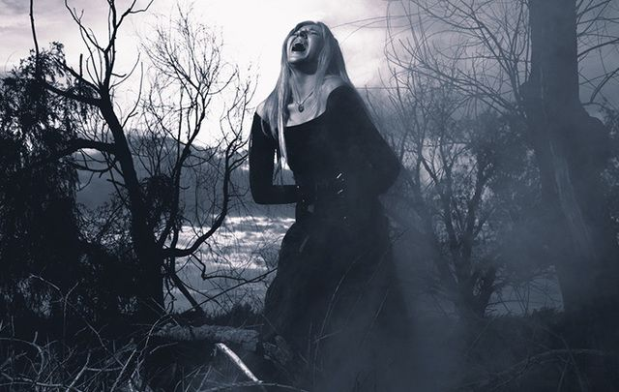
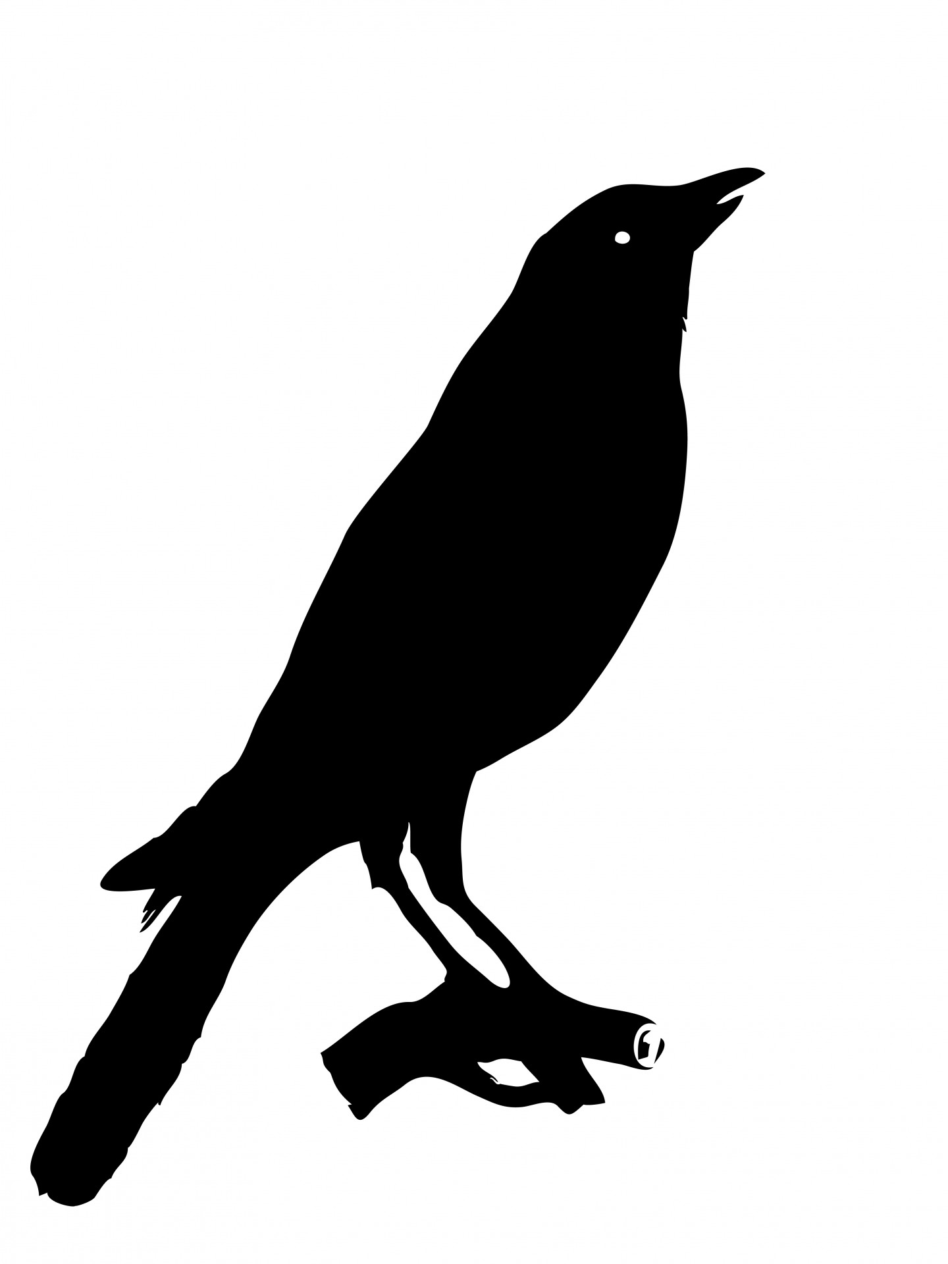
Banshee Appearance
Said to have a few different appearances.
Can be a woman with very long hair, usually white, red, or silver.
Wears a dress or robe, sometimes torn up.
Many legends have her with red eyes and constantly crying.
Can appear as a beautiful young woman, an ugly old hag with physical defects (like bad teeth and one nostril), and sometimes headless & naked carrying a bucket of blood.
Sometimes takes the form of a black crow.
Notes:
Headless banshee picture Second Life Marketplace - Headless Screaming Banshee (coffin Crate)
Screaming Banshee, Old Banhsee, & Black Crow were found using “insert, search from Web” option on Google Docs

Slide 5
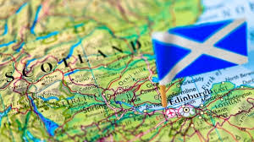
Cultural Background: Scottish
Appearance:
On the Isle of Skye the bean nighe was said to have a squat figure resembling a "small pitiful child".
On the Isles of Mull and Tiree she was said to have unusually long breasts that interfere with her washing so she throws them over her shoulders and lets them hang down her back.
Legends:
If a person catches her she will reveal to him his ultimate fate. She answers all his questions but he must also truthfully answer her’s in return. If however the bean nighe sees him first then he will lose the use of his limbs.
Notes:
Washing women - scottish folklore?
Evil perspective

Slide 6
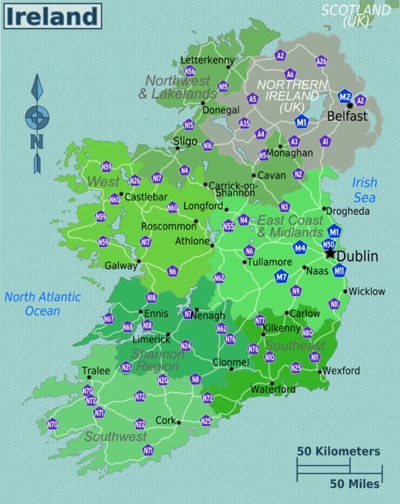
Cultural background: Irish
Appearance:
Sometimes the banshee assumes the form of some sweet singing virgin of the family who died young.
The banshee may also appear in a variety of other forms, such as that of a hooded crow, stoat, hare and weasel - animals associated in Ireland with witchcraft.
Legends:
Irish legend speaks of a lament being sung by a fairy woman; she would sing it when a family member died or was about to die, even if the person had died far away and news of their death had not yet come, so that the wailing of the banshee was the first warning the household had of the death.
Some believe that she acts as an escort to ensure that their loved one passes safely to the other side.
Notes:
Good perspective
Each irish family is said to have their own personal banshee

Slide 7
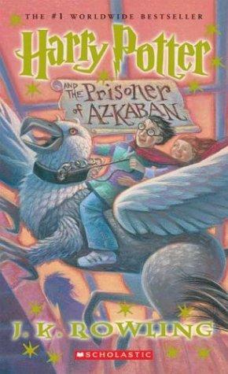
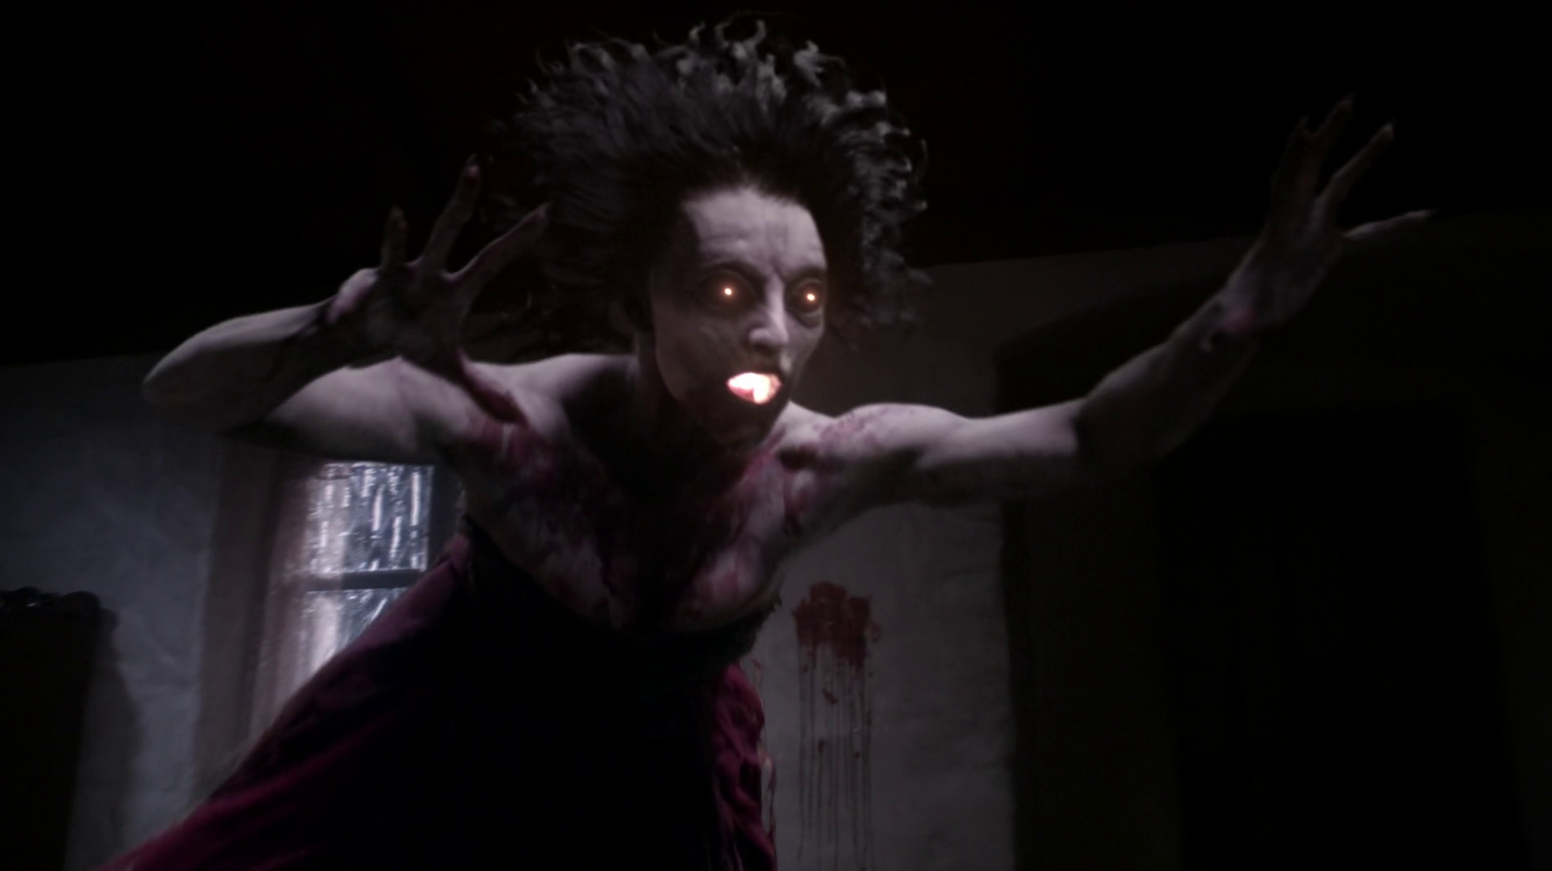
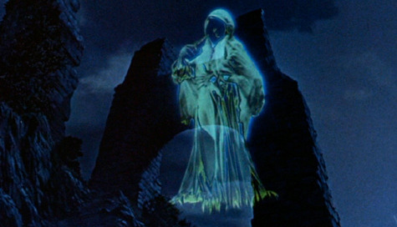
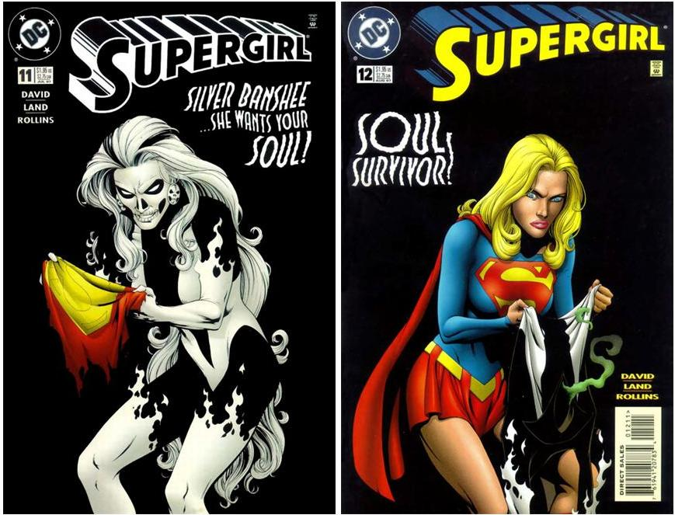
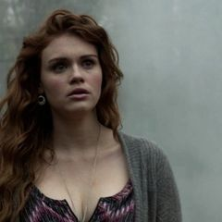
Banshee presence in pop culture
Harry Potter
Supernatural
Disney (Darby O’Gill)
Teen Wolf
DC Comics

Slide 8
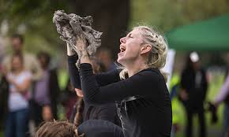
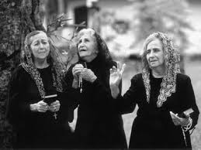
Keeners
To keen is wail in grief for a dead person.
This is an old Irish practice typically performed at funerals by women.
These women were usually associated with being sinners because of their acceptance of alcohol as payment for their services.
This led to keeners becoming outcasts in their communities and over time the practice was even met with backlash from the catholic church.

Slide 9
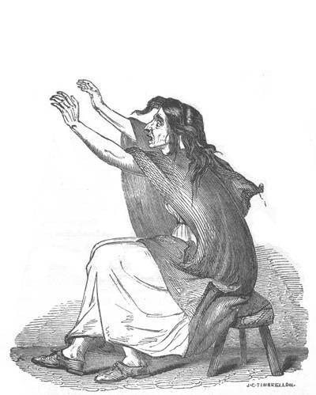
The Keeners evolution into the Banshee
With the practice of keening becoming more taboo as Ireland moved into a more modern era, and the bad scene of the women involved, the banshee was born.
It was believed that these women who had practiced keening in life would be punished in death by becoming a banshee, a life of wailing and mourning for the death of loved ones.
=

Slide 10
Important Cultural Issue: The Role of Women
The Common Role of Women During this Period:
Lived in a dominant patriarchal society
Young women were expected to be subservient to their fathers and their husbands
They were seen as weak creatures both morally and physically, also a great deal of emphasis was placed on their chastity.
How this connects to the Banshee:
Keeners were considered outcasts to society due to fact that they did not follow any of these guidelines for women during this era.
Young women became alcoholics at a young age, changing their appearance (premature wrinkling) and causing them to become an abject member of society.
They were usually banished at a young age due to their repulsiveness
Their role in society was mainly involved with death and the traditional singing during funerals, due to this and others repulsiveness towards them, this soon manifested into the monster we know today.

Slide 11
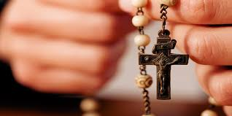
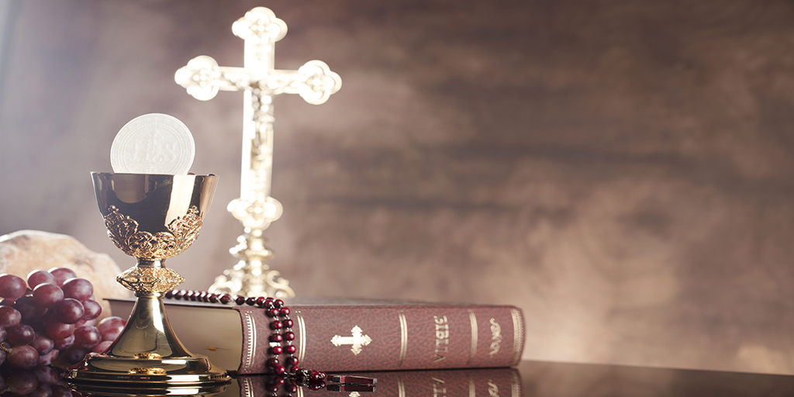
Important cultural issue Catholicism and Class
Issues revolving around catholicism:
The Catholics saw keeners as a disgrace & had them banned.
The women become alcoholics at a young age, they were thought to have had given into temptation and sin.
Class distinctions involving well-off Irish families
The 5 major Irish families: O’Connors, O’Neills, O’Briens, O’Gradys, & Kavanaghs.
They saw the Banshee as a young & beautiful “guardian” for their family.
Poorer families saw her as an old scary hag that brought nothing good.
Has white hair, no teeth, & quite ugly

Slide 12
Thesis 4: The Monster Dwells on the Gates Of Difference
This thesis talks about the “difference made flesh” whether it has to do with cultural, ethical, religious, or other differences. The monster is then stemmed from these differences in an exaggerated form.
The banshee relates to this idea due to the fact that keeners were considered different compared to the normal scottish/irish woman:
They were rejected in society due to their occupation and how they were paid, their alcoholism made them even more abject in the eyes of others.
They were also rejected by the church, who had a very influential role during this time period, making the keeners an even bigger pariah in society.
These differences thus became exaggerated into the banshee.

Slide 13
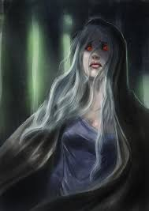
Thesis 5: The Monster Polices the Borders of the Possible
This thesis talks about how the monster prevents mobility (moral conservatism) and warns against taboos.
The Banshee relates to this thesis because they were outcasts and seen as sinners. They were essentially shunned from society.
Banshees were women who drank excessively, so if you were a woman and drank to much you would be shunned (moral conservatism).
It was seen as taboo for women to drink, so if you wanted to have a good reputation it was better for you not to drink or else you would be looked down upon or WORSE turn into a Banshee (warns against taboos).

Slide 14
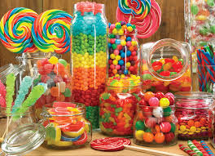
Time for Kahoot!
We will have 10 questions and the top 3 winners will get CANDY!!

